Slide 1

Railway Control Centre
Track Warrant System
TWS

Slide 2
TWS – What is its purpose?
Provide an easy-to-use system to manage key information about train movements through the network
Manage track workers accessing track sections
Support existing operations which may be ‘phone or radio-based
Share information in real-time about train locations

Slide 3
TWS – How does it work?
TWS emulates the traditional signalling processes of ‘Absolute Block Working’ .
TWS stores records of movements to assist in preventing more than one train accidentally occupying the same section at the same time.
The system prevents ‘Movement Warrants’ being issued where the block section is already occupied by another train or track workers.

Slide 4
TWS – How does it work?
TWS is suitable for single lines and for double or multiple track sections, or any combination of these.
TWS can also emulate the signalling processes of ‘Permissive Block Working’ .
The system allows ‘Permissive Movement Warrants’ to be issued, and records how many trains are occupying the block section.

Slide 5
TWS – How does it work?
The following demonstration follows a pair of trains moving around the network
The network in this example is simple but the system can be much more complex.
Have a look at the layout.............

Slide 6
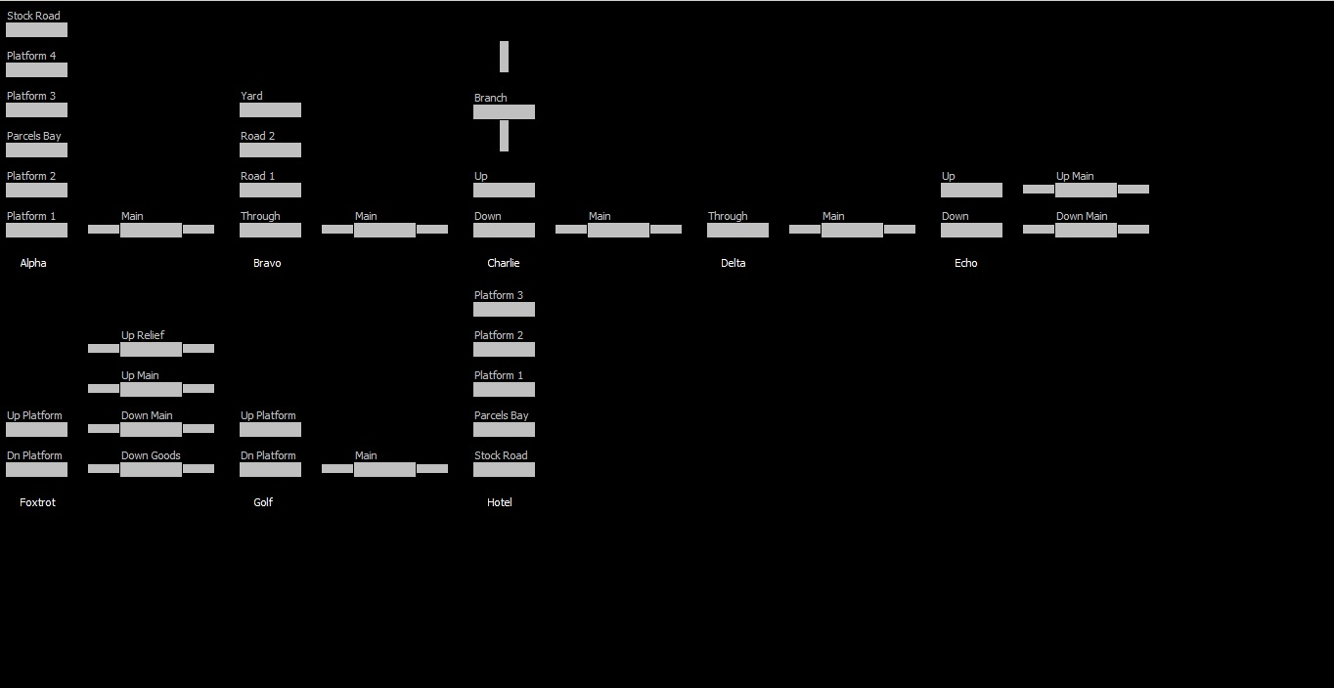
The line runs from Alpha to Hotel via Echo and Foxtrot
Between each station
there is a single line
section of track
Station Alpha has 5
platforms + siding
Station Bravo has 2
platforms , yard and
through road
Between Foxtrot and Golf
there are 4 running lines

Slide 7
TWS – How does it work?
The following demonstration follows
trains moving around the network
We shall move a train in each direction through the network from Station Alpha to Station Charlie

Slide 8
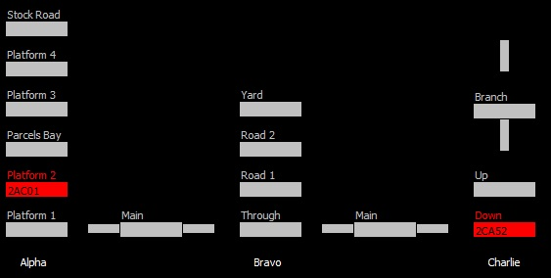
Starting Trains at Alpha and Charlie
Train 2AC01 is in
Platform 2 at Alpha
Train 2CA52 is in Down
Platform at Charlie

Slide 9
Both Trains are now ready to move

Slide 10
Both trains are ready to move
The Controller now issues Warrants:
  2AC01 can move towards BRAVO Ü
  Û 2CA51 can move towards BRAVO

Slide 11
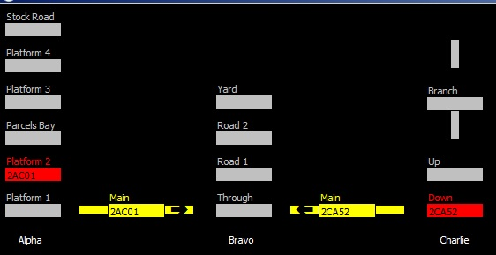
Warrants are issued allowing the trains to enter the sections.
When this is done the Section turns yellow
2AC01 has received
a Warrant to enter the section
from Platform 2 at Alpha
2CA52 has received
a Warrant to enter the section
from Down Platform at Charlie

Slide 12
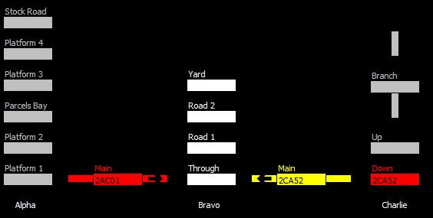
1st Train enters section
2AC01 has now entered the section from Alpha to Bravo. The colour has changed from yellow to red
2CA52 has received
a Warrant but has not yet
left Charlie

Slide 13
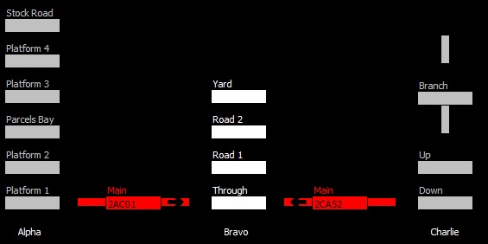
2nd Train enters section
2AC01 is still in the section
from Alpha to Bravo
2CA52 is now in the section
from Charlie to Bravo

Slide 14
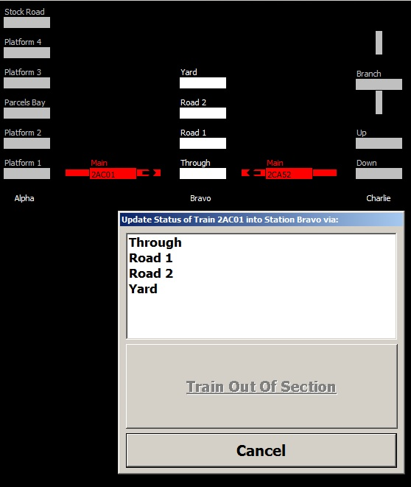
Train 2AC01 is at the end of the section and
the controller needs to select a route at BRAVO
The system shows the controller that Road 2
is available.

Slide 15
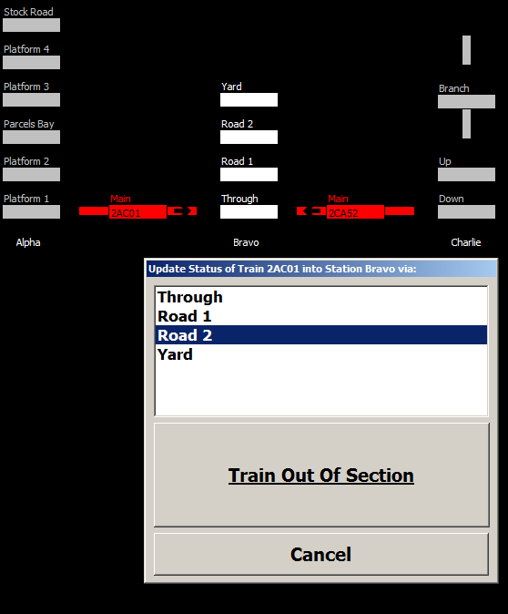
The Controller selects Road 2 at BRAVO
The Controller selects Road 2 and confirms that the train is Out-of-Section

Slide 16
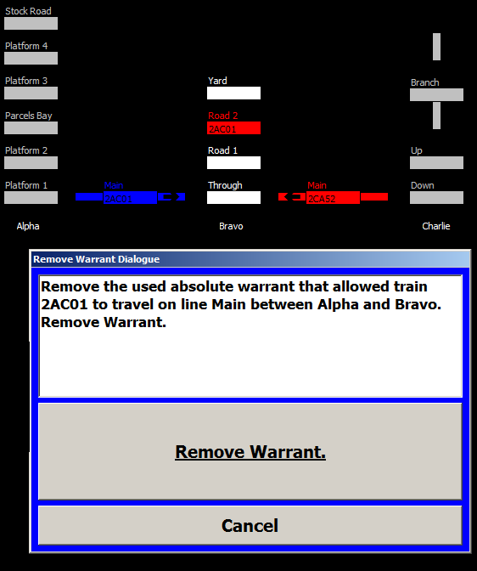
2AC01 is now in Road 2 at BRAVO
Controller can now remove the warrant from 2AC01. Track berth changes to blue to indicate that warrant has not been removed.

Slide 17
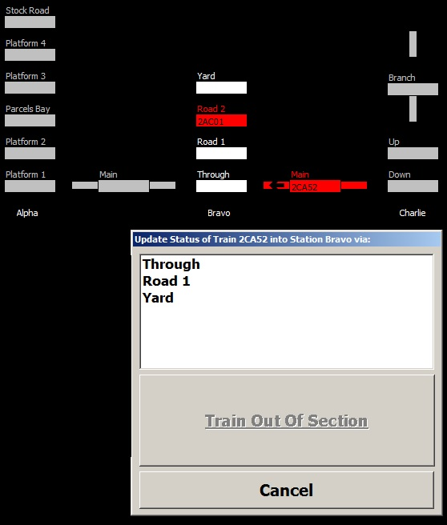
Train 2CA52 is at the end of the section and
the controller now needs to select a route at BRAVO
Note that Road 2 is no longer shown on the selection list as it is already occupied by 2AC01
The controller selects the Through Road at Bravo

Slide 18
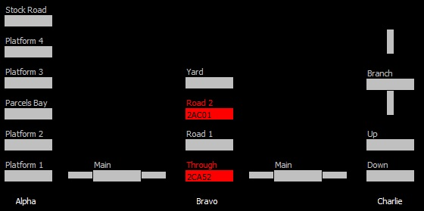
Trains 2AC01 and 2CA52 are now at BRAVO
Both trains have given up their warrants. Neither have permission to move further through the network

Slide 19
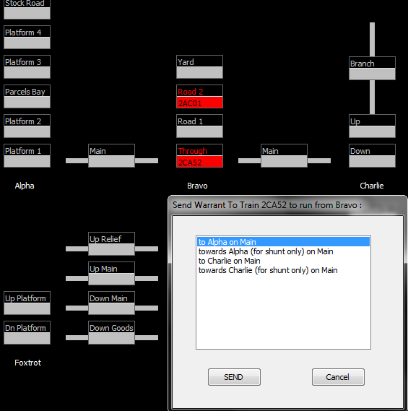
Send 2CA52 towards ALPHA
There is a choice of 4 warrants which can be issued to 2CA52
The Controller issues a warrant for 2CA52 to move towards Alpha on the Main Line

Slide 20
Moving on....
.... Both trains are now in section approaching their destinations

Slide 21
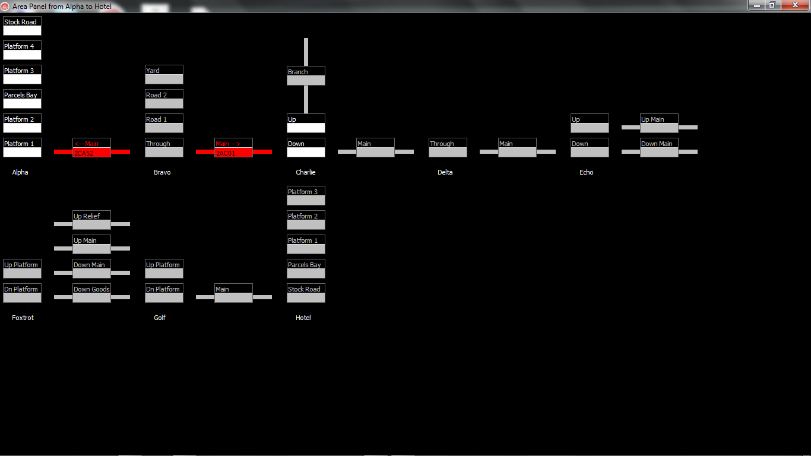
Both trains have departed from BRAVO

Slide 22
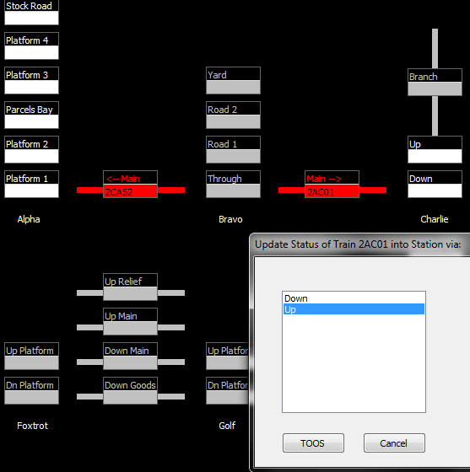
2AC01 is approaching Charlie
Before 2AC01 leaves the section, the controller routes the train into the Up Platform
Pressing the TOOS button (Train-out-of-section) moves the train into the Up Platform

Slide 23
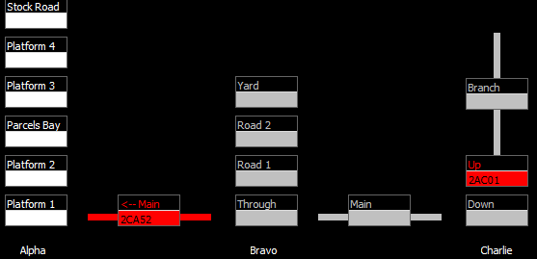
2AC01 has left the section and now is in Up Platform at Charlie
The section between Bravo and Charlie can now be reoccupied

Slide 24
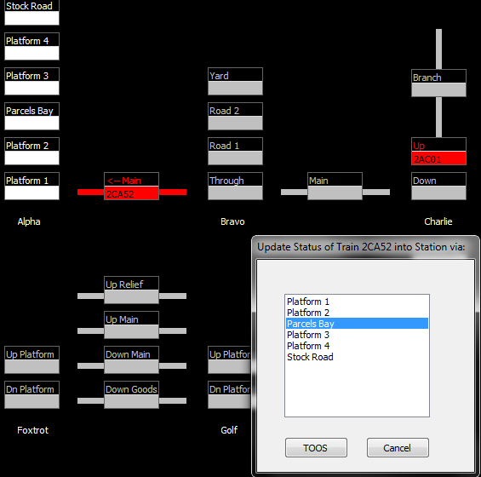
2CA52 is now approaching ALPHA
Before 2CA52 leaves the section, the controller routes the train into the Parcels Bay
Pressing the TOOS button (Train-out-of-section) moves the train into the Parcels Bay

Slide 25
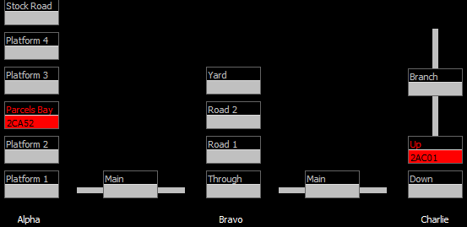
Both trains have reached the end of their journeys

Slide 26
The ART Track Warrant System has managed the safe movement of trains 2AC01 and 2CA52 through the network

Slide 27
Permissive Block Working

Slide 28
The ART Track Warrant system will allow several trains to occupy a particular block section if the controller selects ‘permissive block working’ for that section of line.

Slide 29
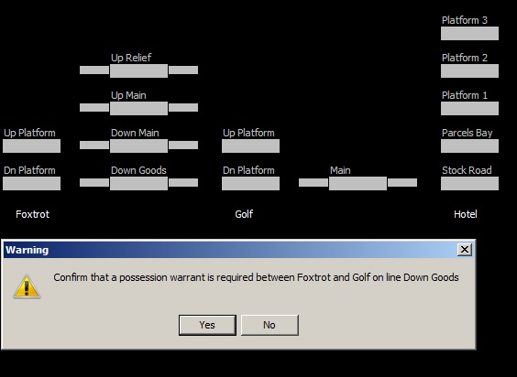
The controller has requested permissive working between Foxtrot and Golf on the Down Goods line

Slide 30
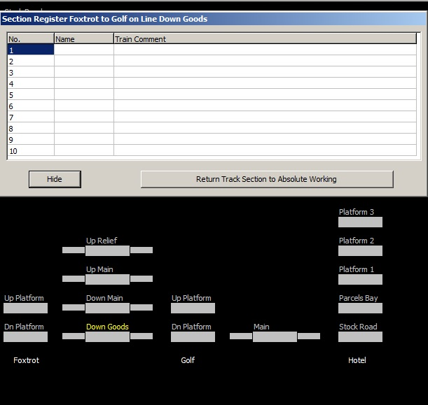
Up to 10 trains can occupy the permissive section; their identities are recorded in the Section Register

Slide 31
Safely digging up the track

Slide 32
The ART Track Warrant system will also manage access for engineers to safely work on the track

Slide 33
“Engineers want to maintain the Down Main track between Golf and Foxtrot”

Slide 34
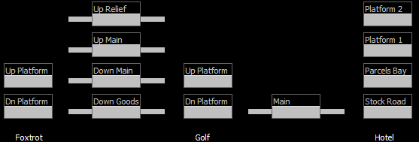
Possession needs to be taken on a 4 Track Section
Up Main & Up Relief Ü
from Foxtrot to Golf
  Û Down Main & Down Goods from Golf to Foxtrot
Down Main section
between Golf and Foxtrot
to be blocked

Slide 35
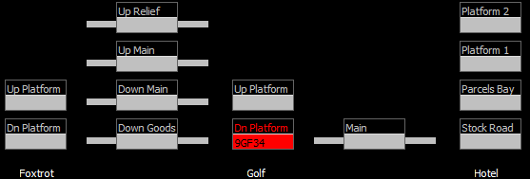
9GF34 is in the Down Platform at Golf Station
  Û 9GF34 is going to Foxtrot

Slide 36
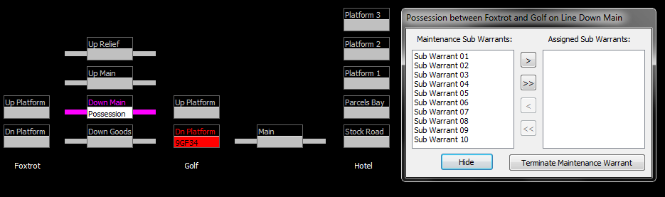
An Engineering Possession is authorised
  A Possession is authorised on the Down Main

Slide 37
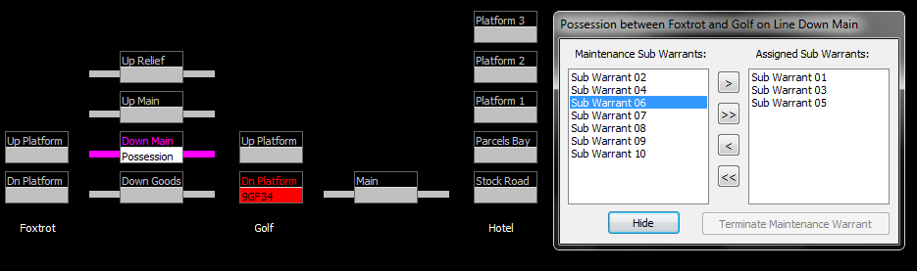
An Engineering Possession is authorised
  A Possession can be divided into 10 ‘Sub-Warrants’ allowing multiple worksites within a single sections.

Slide 38
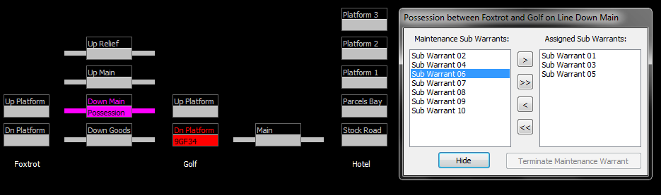
An Engineering Possession is authorised

Slide 39
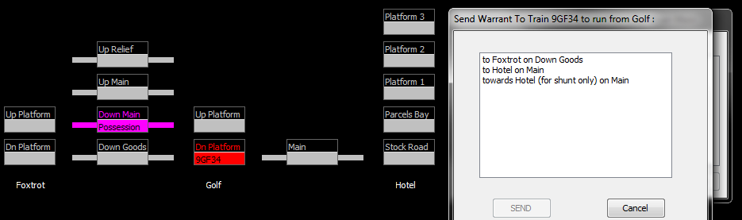
Issue Movement Warrant to 9GF34 to move towards Foxtrot
  The only available Movement Warrant to Foxtrot is on the Down Goods .
  There is still an Engineering Possession on the Down Main.

Slide 40
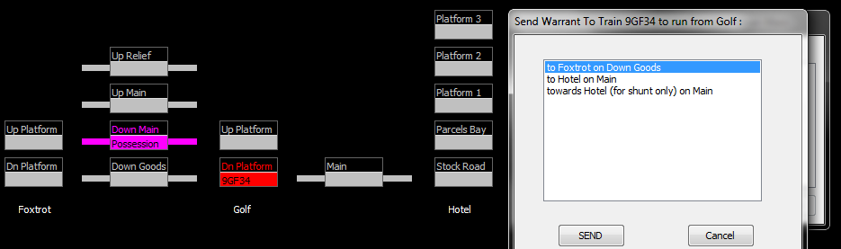
9GF34 receives Movement Warrant to Foxtrot via Down Goods
  The Controller selects the Down Goods Warrant and sends it to the driver.

Slide 41
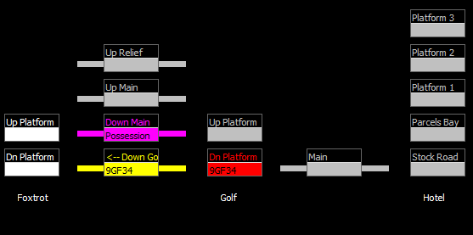

Slide 42
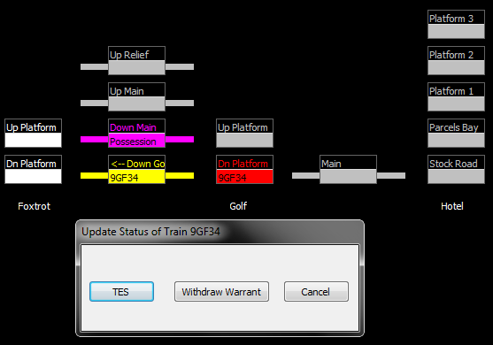
9GF34 enter the section
  Pressing the ‘TES’ (Train-entering-section) button confirms that 9GF34 is now between Golf & Foxtrot.

Slide 43
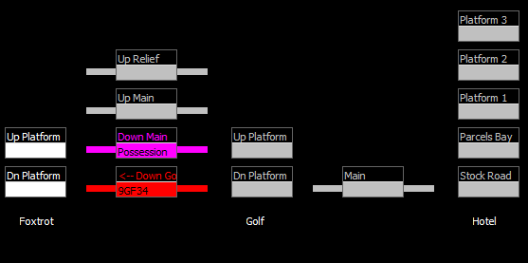
9GF34 is between Golf and Foxtrot
  The colour has changed from yellow to red as the train is now in section

Slide 44
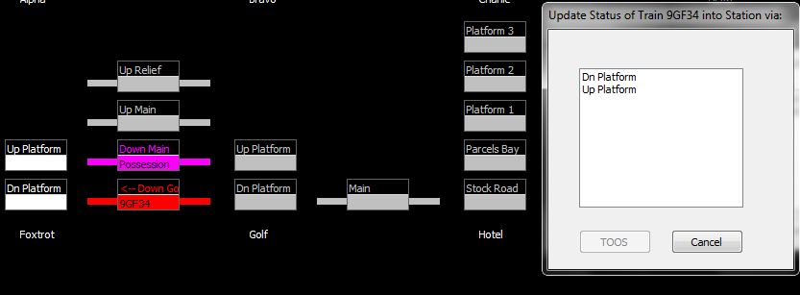
9GF34 approaches Foxtrot and leaves the section
  Both Platforms are available at Foxtrot
  The Controller selects the Down Platform

Slide 45
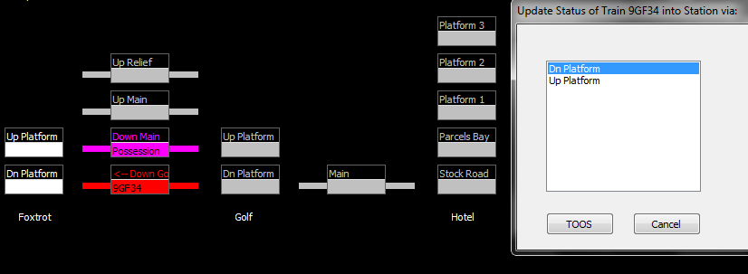
9GF34 is routed to the Down Platform
  The Controller confirms that 9GF34 has arrived at Foxtrot by pressing the ‘TOOS’ button.

Slide 46
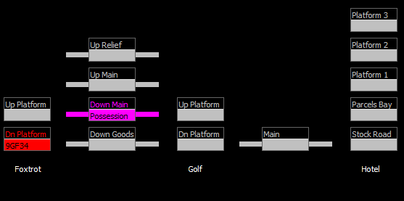
9GF34 has arrived at Foxtrot
  The Engineers are still working between Golf and Foxtrot on the Down Main

Slide 47
The Engineers are ready to give up their Possession

Slide 48
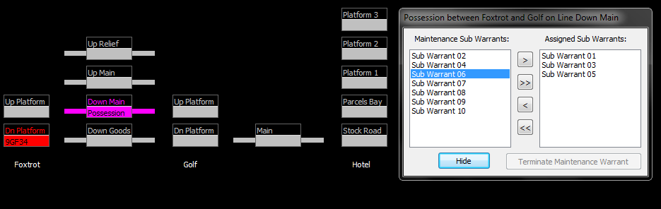
Giving up the Engineering Possession
  The Engineers still have Sub-Warrants for 3 worksites in the Possession

Slide 49
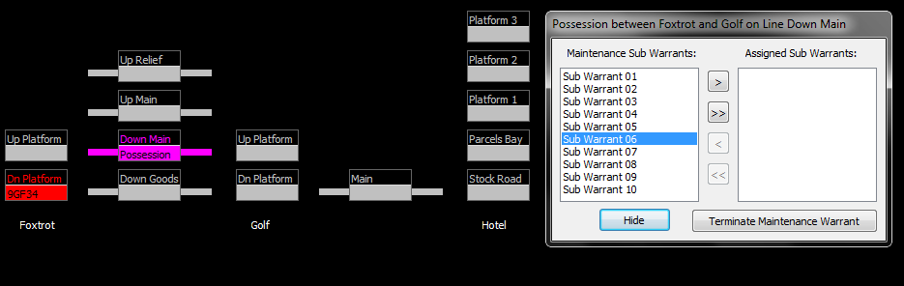
All of the Engineering Work is completed
  Now all of the Sub-Warrants have been handed back

Slide 50
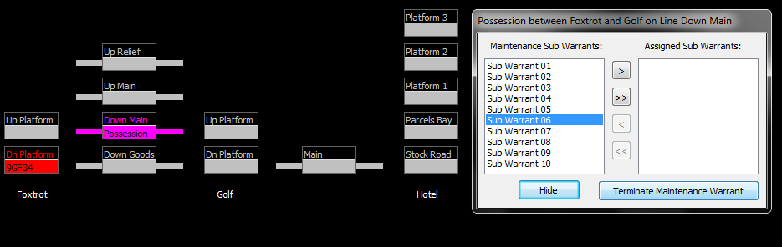

Slide 51
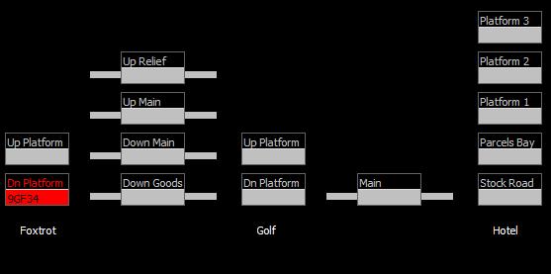
The Engineers have completed their work

Slide 52
Hardware and software

Slide 53
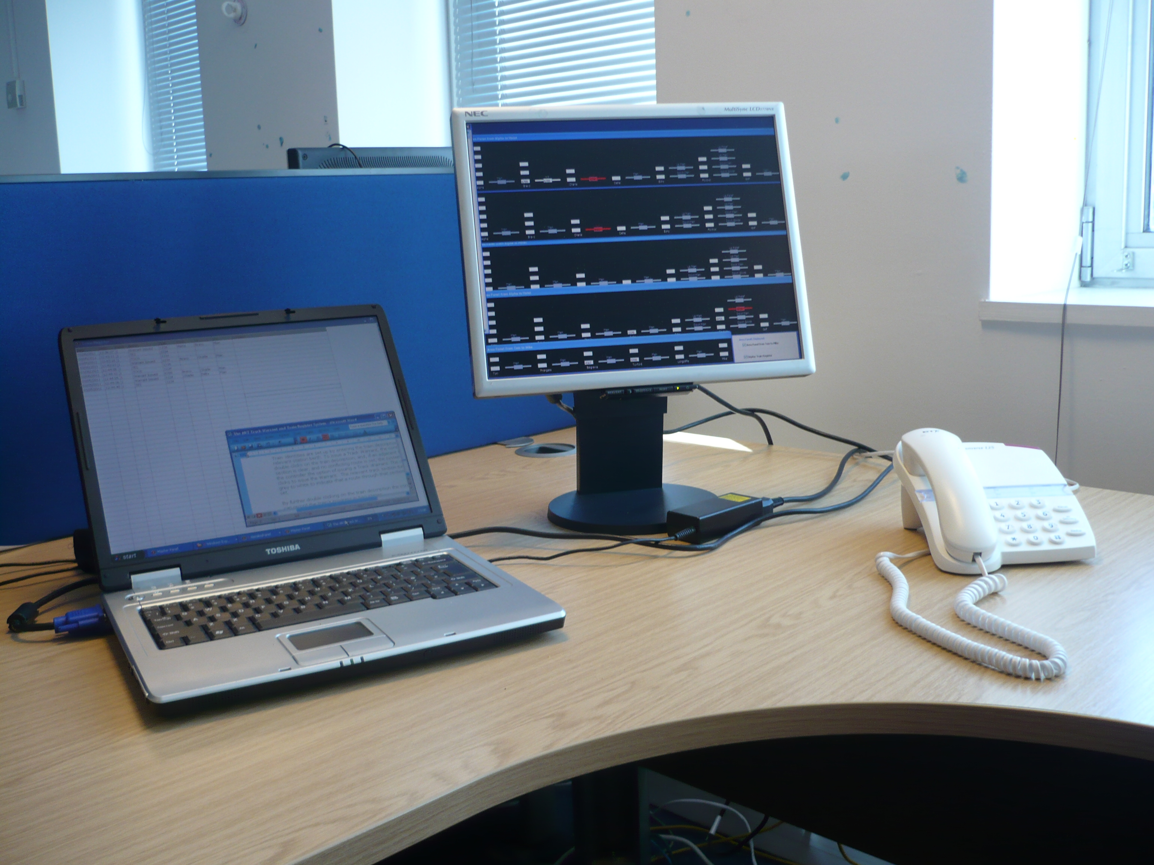
TWS can run on any Windows-based system

Slide 54
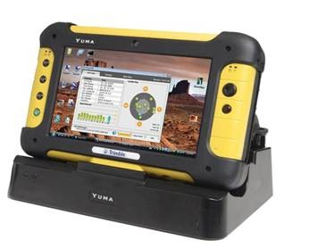
TWS can run in standalone mode, or it can be networked
The software includes provision for remote units, for example to provide a screen display in a remote office
The software also supports mobile remote units such as a ruggedised tablet, suitable for locomotive on-board use. This will need a suitable radio link

Slide 55
ART Track Warrant benefits...
Provides a simple, low-cost means of overseeing train movements around the network
All of the transactions are written to a Train Register log which can be audited
The system is extendable to incorporate
  Additional ‘dumb’ terminals for viewing network use from other offices and locations
  Shore to locomotive direct computer access
  GPS verification of locomotive position
  Verification of end-of-train position via GPS
The system will work non-stop 24 * 7

Slide 56
Railway Control Centre
Track Warrant System
www.advancedrailtech.com
TWS

